Slide 1

TECH NERDS
TEAM MEMBERS
PRATYUSH GUPTA
SUBHASISH KUMAR BEHURA
SOMNATH BANERJEE
BM PRIYESH KUMAR

Slide 2
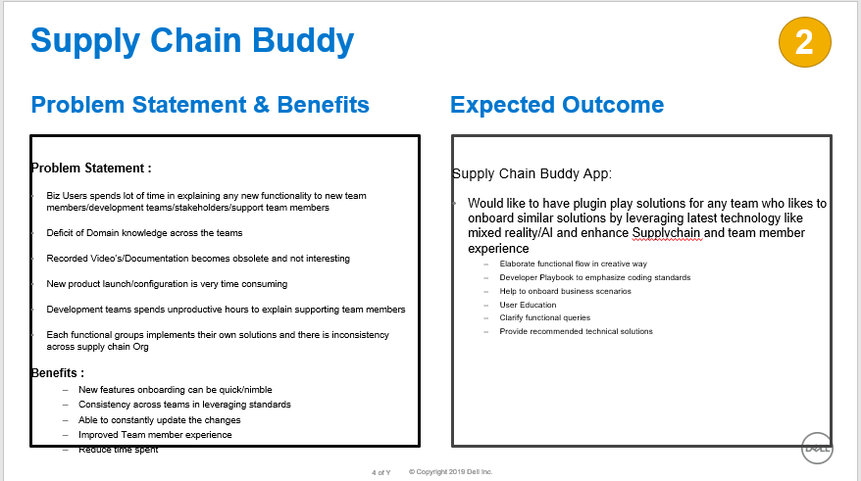

Slide 3
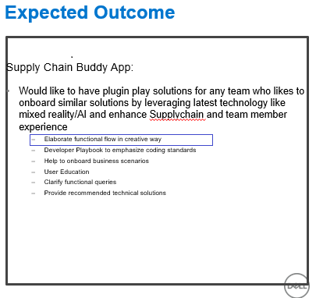

Slide 4
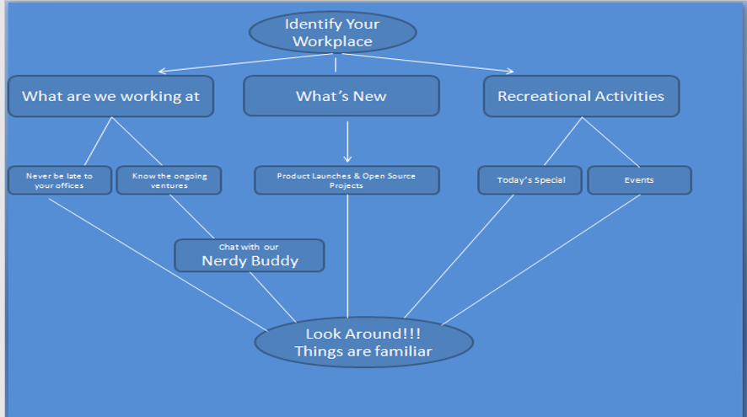

Slide 5
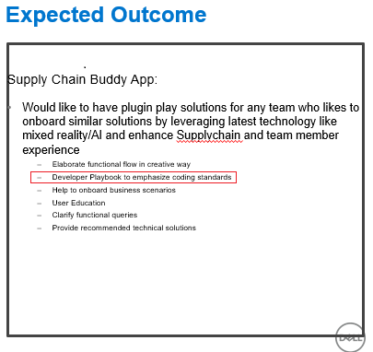

Slide 6
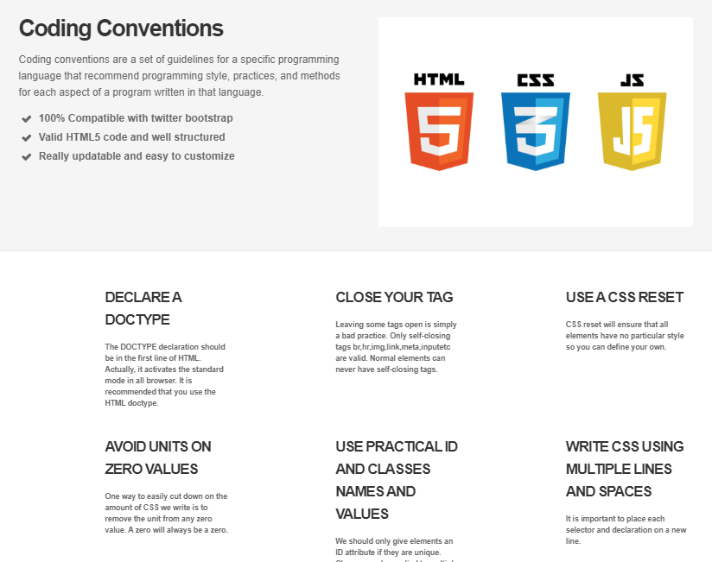

Slide 7
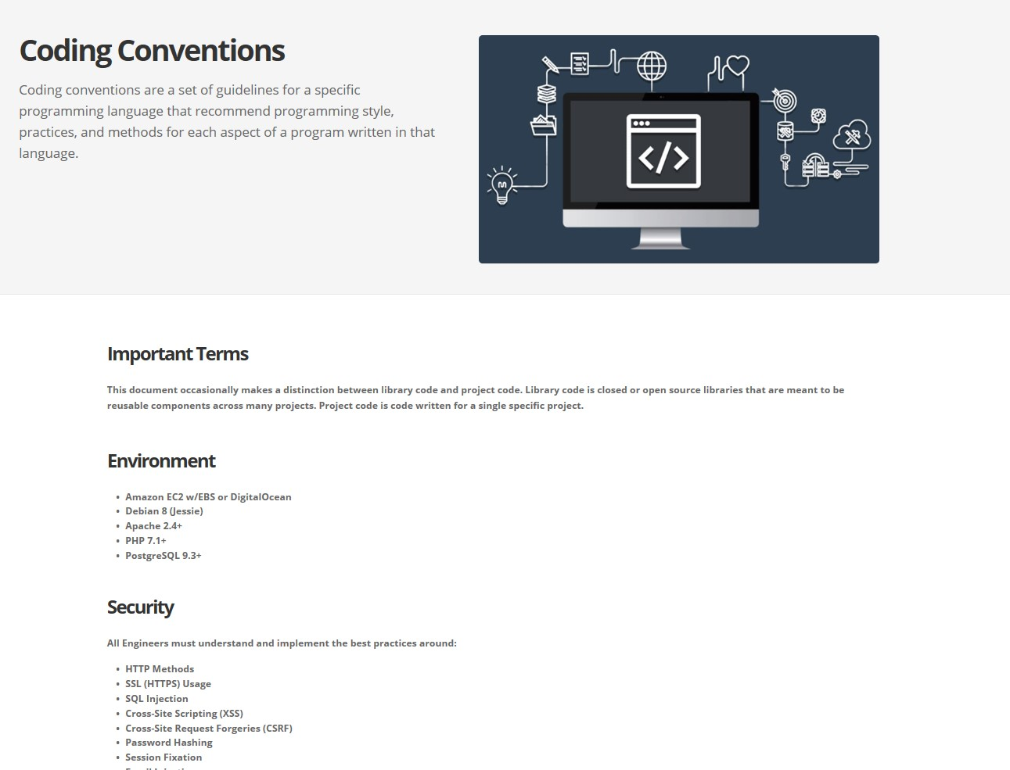

Slide 8
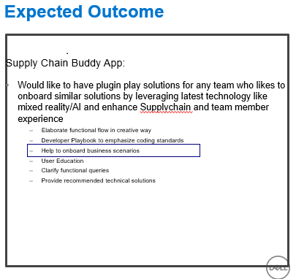

Slide 9
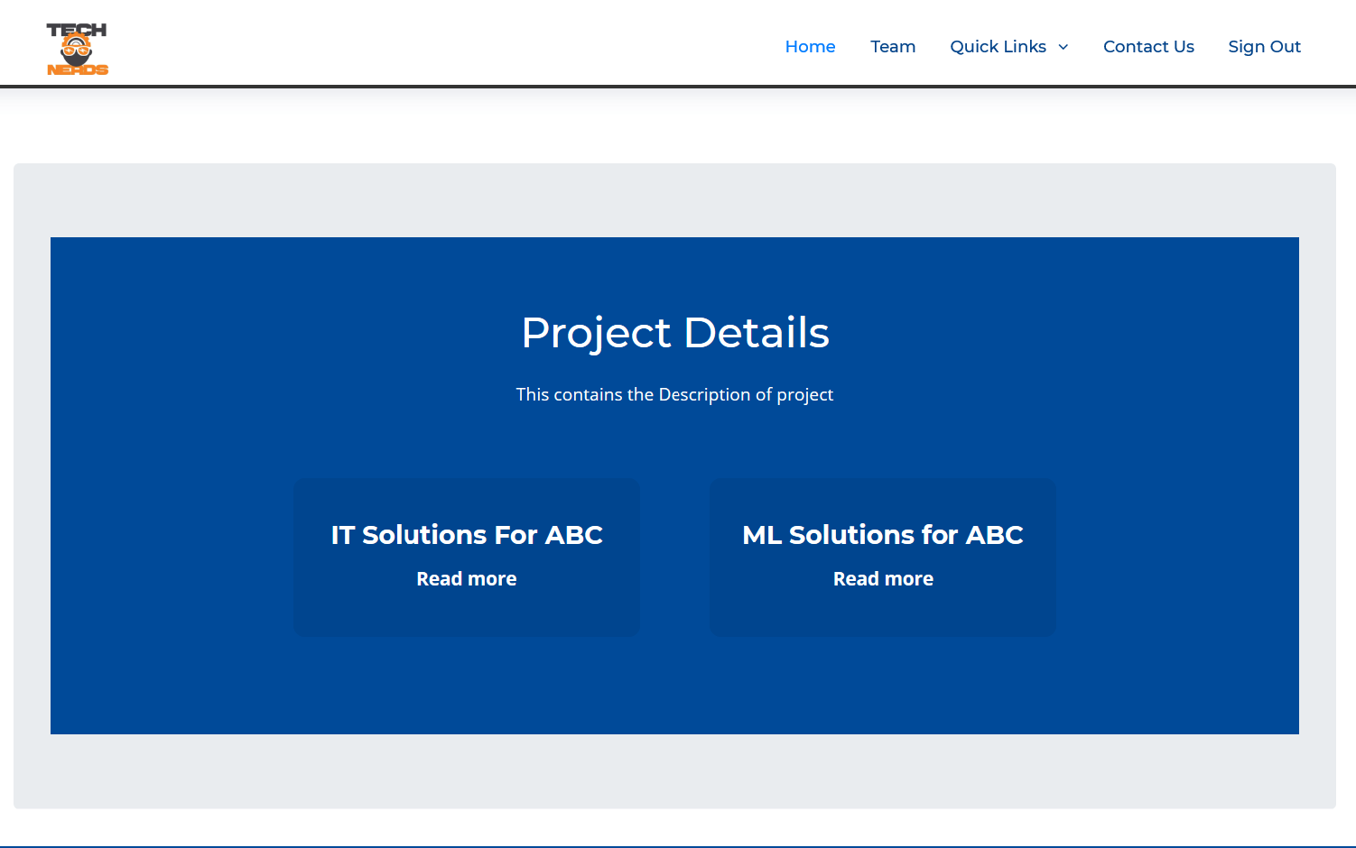

Slide 10
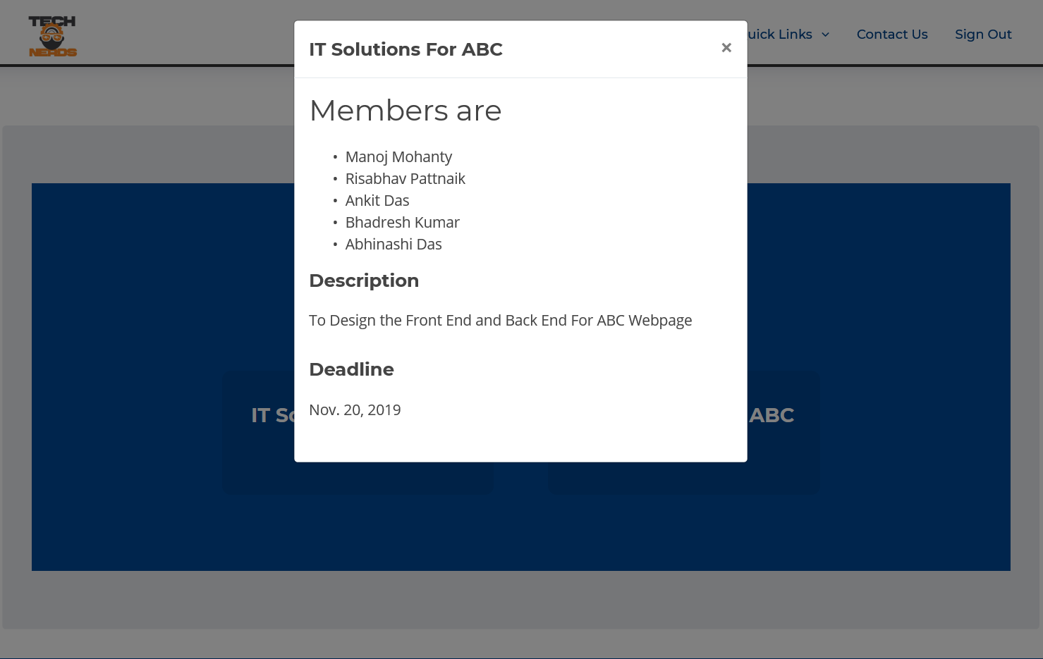

Slide 11
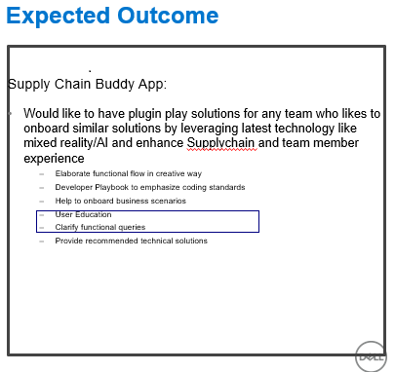

Slide 12
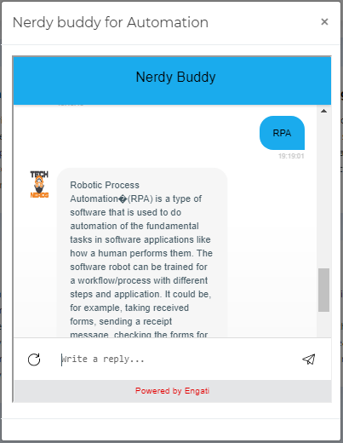

Slide 13
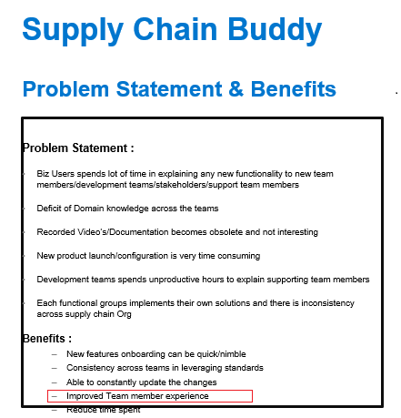

Slide 14
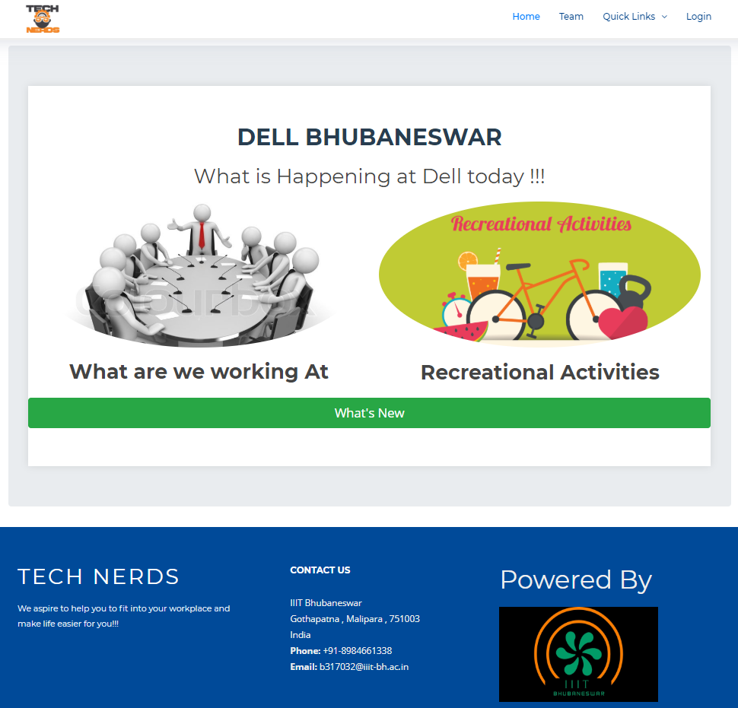

Slide 15
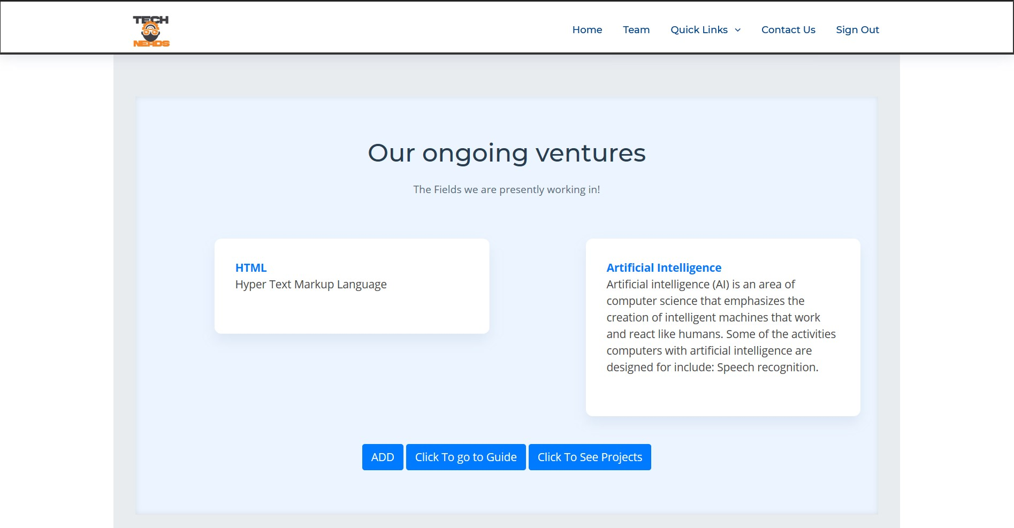

Slide 16
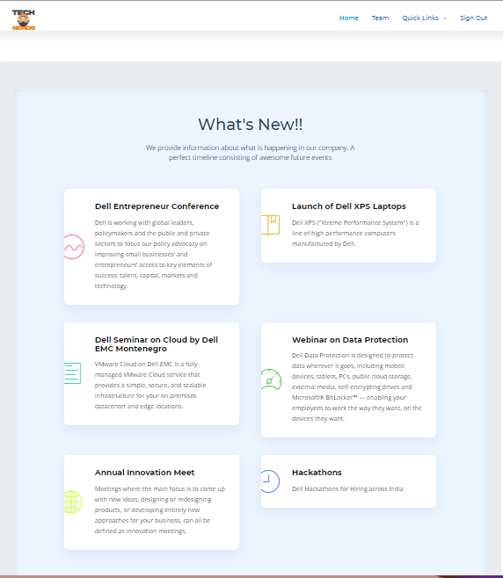

Slide 17
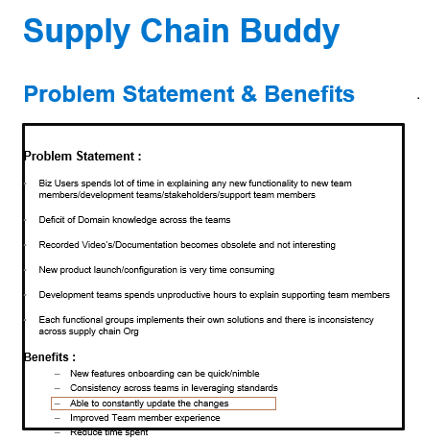

Slide 18
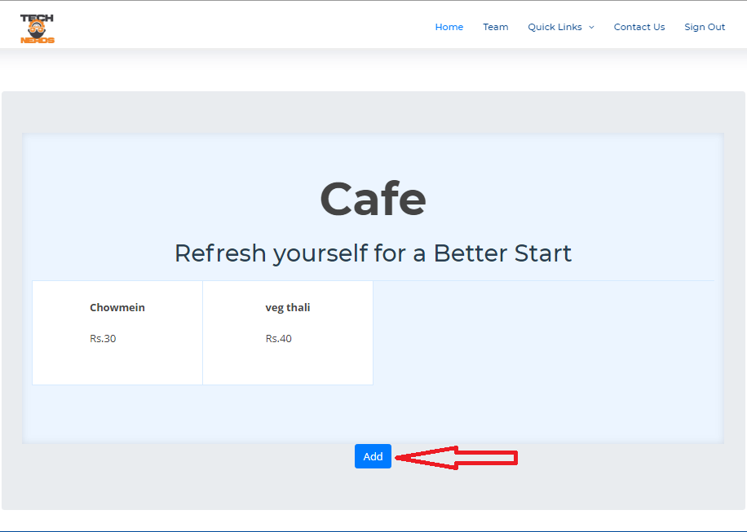

Slide 19
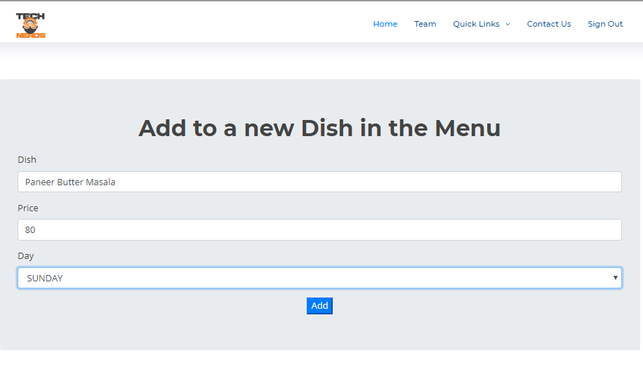

Slide 20
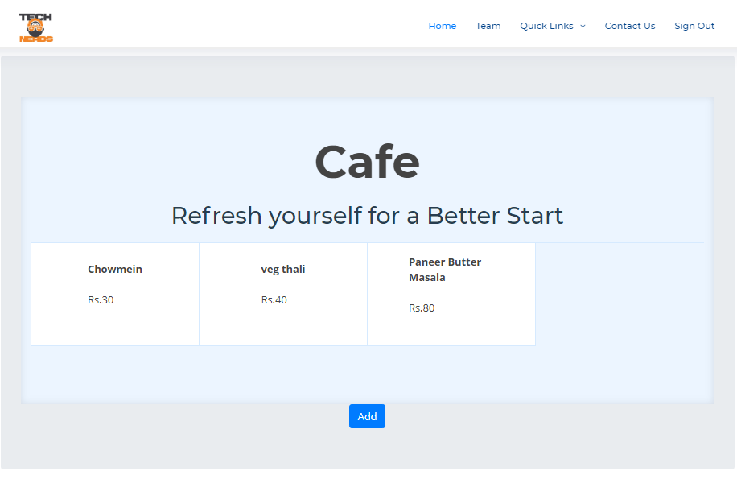

Slide 21
BATTLING SECURITY ISSUES

Slide 22
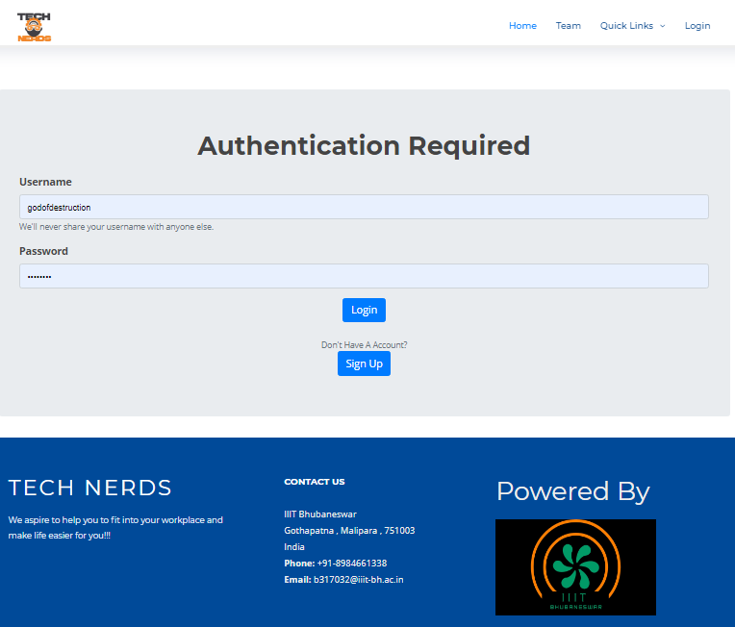

Slide 23
DEMONSTRATION

Slide 24
FUTURE SCOPE AND IMPROVEMENTS
We plan to implement Machine learning in customizing the course selection and recommendations based on the users choice
Using complete plug in play solutions to expand the field of action so that it is neither company specific nor location specific

Slide 25
THANK YOU

